Slide 1

University of Windsor
RECURRENT NEURAL NETWORKS (RNNs)
Team Members
Divykumar Sachapara
Khushbuben Ramoliya
Smit Sanjaykumar Patel
Instructor – Dr. Yasser Alginahi October 27th , 2023

Slide 2
Table of Content
Sequential model
Types of RNN
RNNs: Computational graph across time
RNN from scratch
Sequence modeling design criteria
Back propagation through time
Standard RNN gradient flow
Problem of long-term dependencies
Architecture of LSTM
Advantages and disadvantages of RNN

Slide 3
What is sequencing?
???
[Source: https://tinyurl.com/3pawnch9 ]
Given an image of a ball, can you predict where it will go next?

Slide 4
[Source: https://tinyurl.com/3pawnch9 ]
Given an image of a ball, can you predict where it will go next?

Slide 5
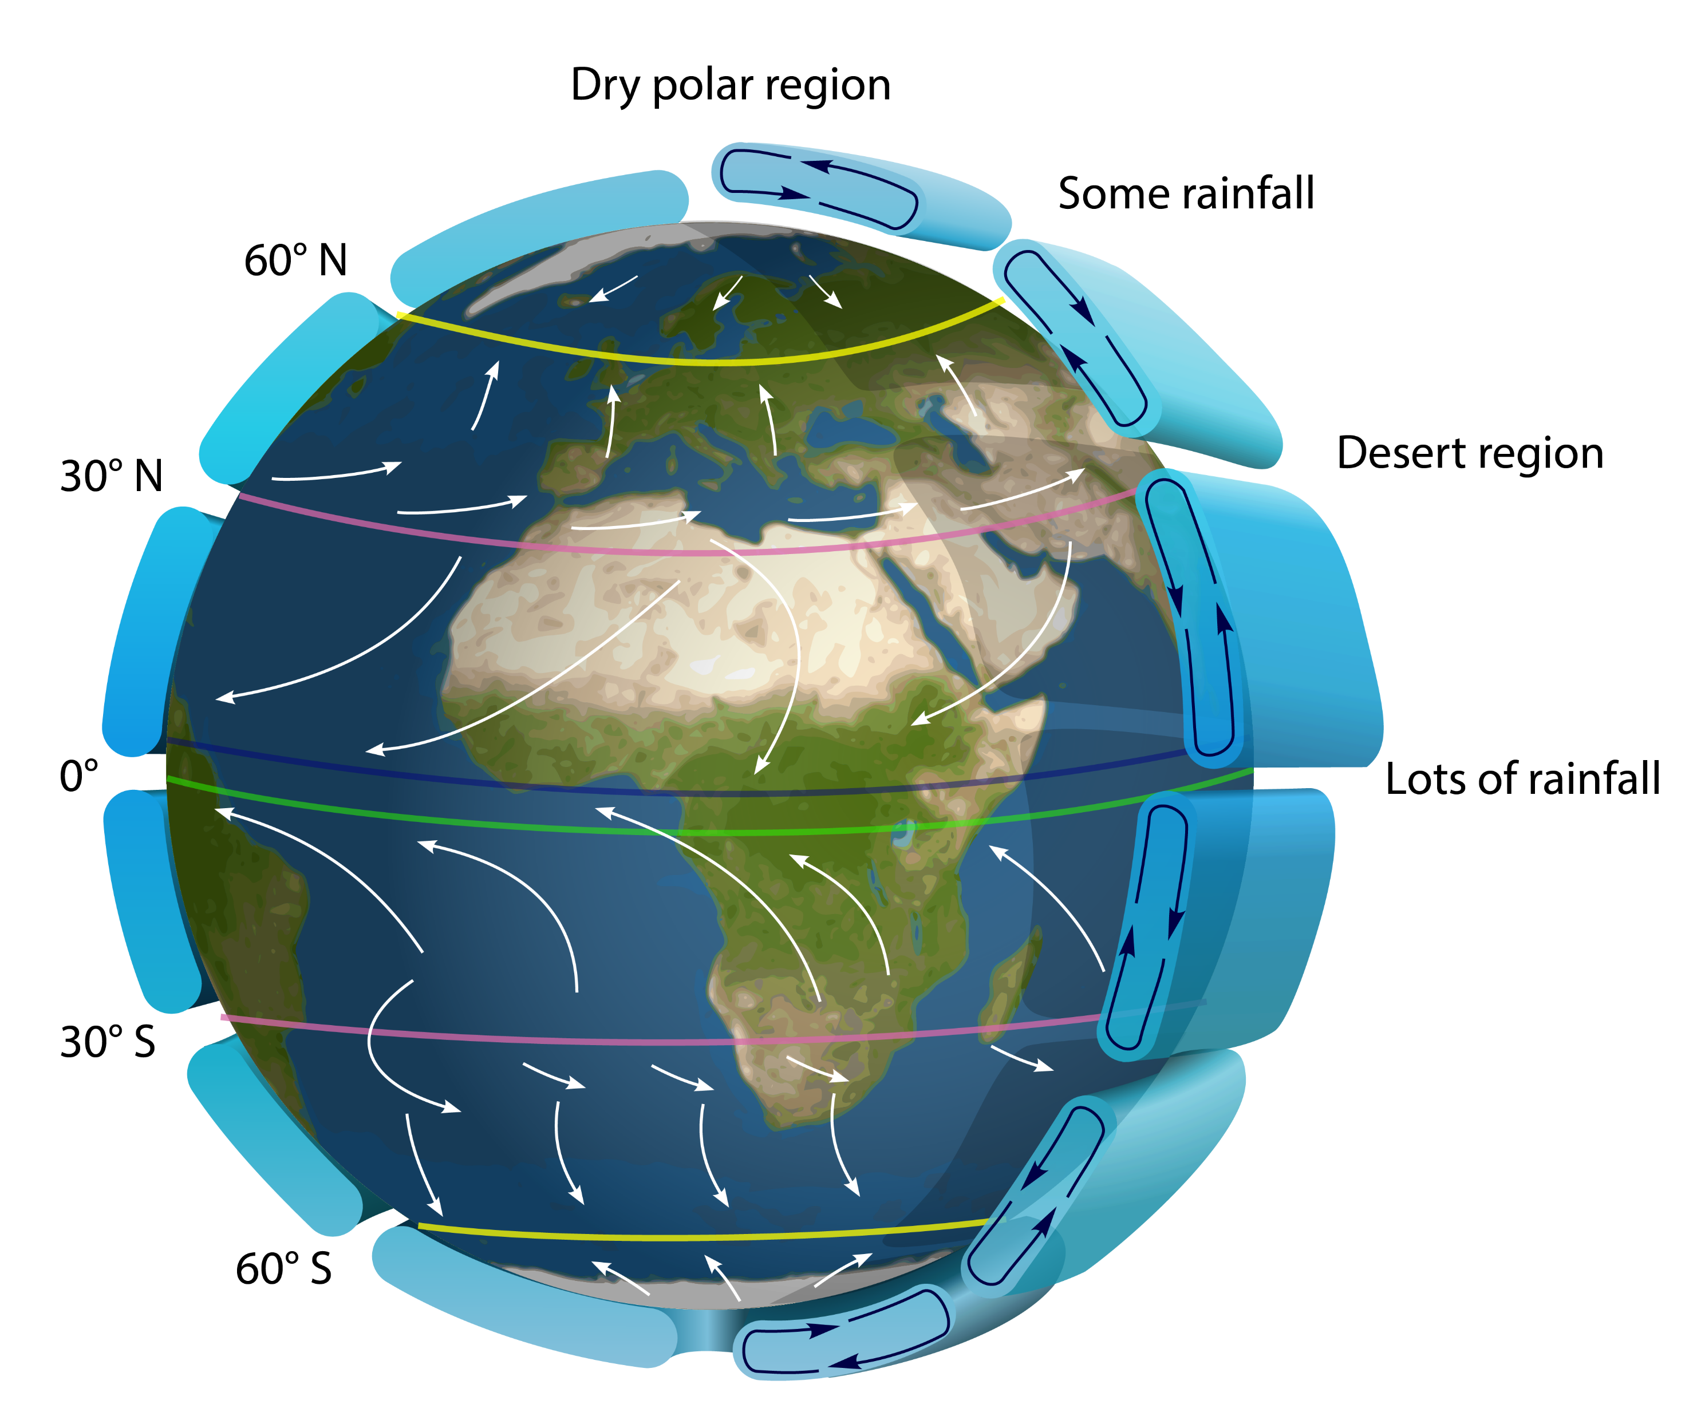





Slide 6
What is RNN and how does it differ from CNN?
Recurrent Neural Networks (RNNs) are a class of neural networks that are designed to handle sequential data by maintaining a hidden state that carries information from one time step to the next.[1]
A convolutional neural network (CNN) is a powerful artificial neural network primarily used for image recognition and processing because it can recognize patterns in images, but it demands millions of labeled data points for training.[2]
In a CNN, it takes in images of a fixed size and produces a predicted class label for each image, along with a confidence level. In contrast, in RNNs, the input size and resulting output can vary.[3]

Slide 7
Sequential Model
Sequential modeling in the context of Recurrent Neural Networks (RNNs) refers to the process of modeling and predicting sequential data, where the order of elements in the sequence matters.
RNNs are a type of neural network designed specifically for sequential data.
They are characterized by their ability to maintain a hidden state that captures information from previous elements in the sequence, which can be used to influence predictions for the next element.
Sequential data includes any data where the order of elements is significant. This can include time series data, natural language text, audio signals, DNA sequences, etc.[4]

Slide 8






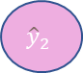
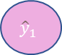

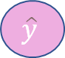
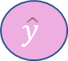
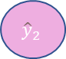
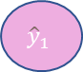
Sequence Modeling Applications and its Types
$${\hat{y}}_{1}$$
$${\hat{y}}_{2}$$
$${\hat{y}}_{3}$$
$${\hat{y}}_{1}$$
$${\hat{y}}_{2}$$
$${\hat{y}}_{3}$$
Will I pass this Class !!?
Binary Classification
x
Sentiment Classification
x1
x2
x3
One to one
One to many
Many to one
many to many
Image Captioning
$$\hat{y}$$
Google/Media Translator
Output
$$\hat{y}$$
Neuron
Input
x
x1
x2
x3
A Baseball player throws a ball !!
[Source: https://tinyurl.com/3pawnch9 ]

Slide 9
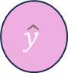

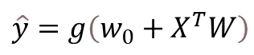
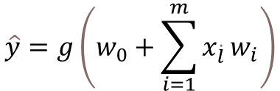
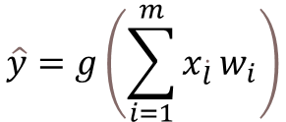
The Perceptron
1
The structural building block of deep learning.
w0
x1
$$\hat{y}=g\left(\sum_{i=1}^{m}{x_{\dot{l}}}w_{i}\right)$$
w1
Output
$$Σ$$
∫
$$\hat{y}$$
linear combination of inputs
x2
w2
Non-linear activation function
Bias
w3
$$\hat{y}=g\left(w_{0}+\sum_{i=1}^{m}{x_{\dot{l}}}w_{i}\right)$$
x3
source : https://tinyurl.com/3pawnch9
$$\hat{y}=g\left(w_{0}+X^{T}W\right)$$
Inputs Weights Sum Non-Linearity Output
Sigmoid and tanh are two of the most common non-linear functions in deep learning.

Slide 10
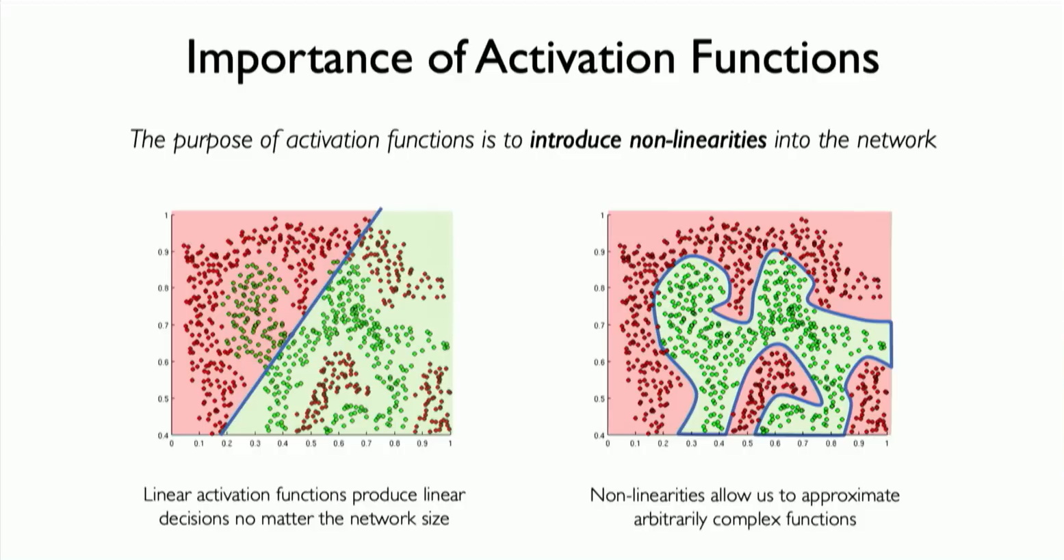
Importance of Activation Functions
The Purpose of activation function Is to introduce non-linearities into the network.
Linear activation function produce linear decisions no matter the network size.
Non-linearities allow us to approximate arbitrarily complex functions.
[Source: https://tinyurl.com/3pawnch9 ]

Slide 11
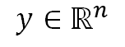
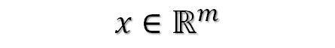
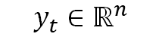
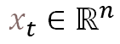
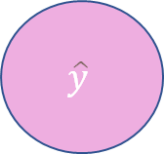
Feed-Forward Networks
$$\hat{y}$$
y1
x1
y2
x
x2
y3
Xm
Yn
$$x∈ℝ^{m}$$
$$y∈ℝ^{n}$$
$$x_{t}∈ℝ^{n}$$
$$y_{t}∈ℝ^{n}$$
[Source: https://tinyurl.com/3pawnch9 ]

Slide 12
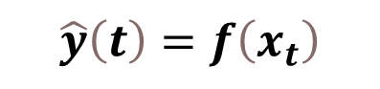
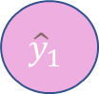
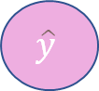
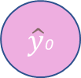
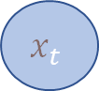
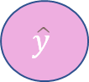
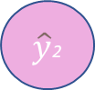
Handling Individual Time Steps
Output vector
$$\hat{y}$$
$\hat{y}$0
$${\hat{y}}_{1}$$
$\hat{y}$2
$$\hat{y}$$
xt
Input Vector
$$x_{t}$$
x0
x1
x2
$$\hat{y}\left(t\right)=f\left(x_{t}\right)$$
[Source: https://tinyurl.com/3pawnch9 ]

Slide 13
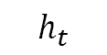
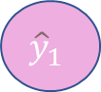
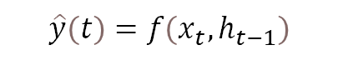
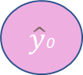
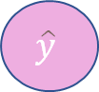
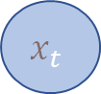
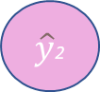
Neurons with Reccurence
Output vector
$$\hat{y}$$
$\hat{y}$0
$${\hat{y}}_{1}$$
$\hat{y}$2
$$h_{t}$$
h0
h1
Input Vector
$$x_{t}$$
x0
x1
x2
$$\hat{y}\left(t\right)=f\left(x_{t},h_{t−1}\right)$$
OUTPUT
INPUT
PAST MEMORY
[Source: https://tinyurl.com/3pawnch9 ]

Slide 14
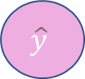
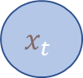
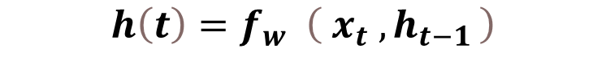
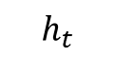
Recurrent Neural Networks(RNNs)
Output vector
$$\hat{y}$$
Apply a recurrence relation at every time step to process a sequence.
$$h_{t}$$
$$h\left(t\right)=f_{w} \left({ x}_{t} ,h_{t−1 }\right)$$
Cell State
Function with weights w
Input
Old state
Input Vector
$$x_{t}$$
Note: The same function and set of parameters are used at every time step.
RNNs have a state $h_{t},$ that is updates at each time step as a sequence is processed.

Slide 15
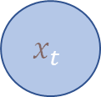
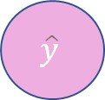
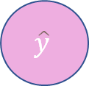
RNN INTUITION
,
my_rnn = RNN() (#Define RNN)
hidden_state = [0, 0, 0, 0] (#Initiate hidden state)
sentence = ["I","love","recurrent", "neural"] (#Input)
for word in sentence: (#For loop for sequencing through I/P)
prediction, hidden_state = my_rnn(word, hidden_state)
next_word_prediction = prediction (#Prediction for last word)
# >> "networks!"
Output vector
Output vector
$$\hat{y}$$
$$\hat{y}$$
,
,
xt
Input Vector
$$x_{t}$$
Input Vector
GitHub link: https://github.com/KhushbuKathrotiya/RNN_Next_Sequence_Word

Slide 16

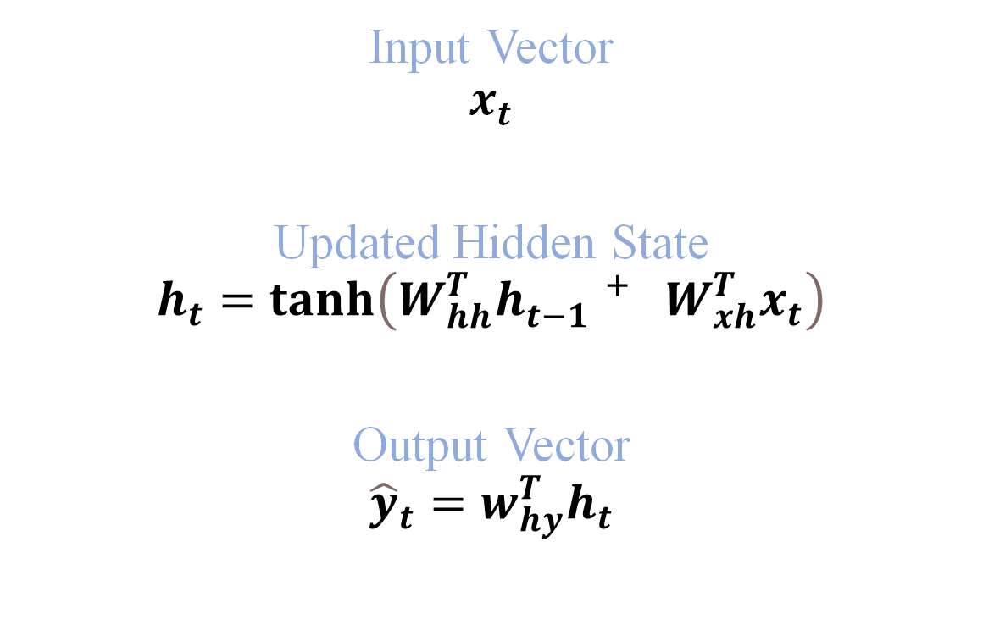
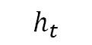
RNN State Update and Output
Input Vector
$$x_{t}$$
Updated Hidden State
$$h_{t}=tanh\left(W_{hh}^{T}h_{t−1}^{ + }W_{xh}^{T}x_{t}\right)$$
Output Vector
$${\hat{y}}_{t}=w_{hy}^{T}h_{t}$$
Output vector
$$\hat{y}$$
$$h_{t}$$
Input Vector
$$x_{t}$$
[Source: https://tinyurl.com/3pawnch9 ]
$W_{hh}^{T}$, $W_{xh}^{T}$, $w_{hy}^{T}$ = Weight matrices

Slide 17
RNNs: Computational Graph Across Time:
Represent as a computational graph unrolled across time
Wyh = Weight matrices define to update to generate predicted output
Re-use the same weight matrices at every time step
Yt
Y0
Y1
Y3
Yt
Whh = Weight matrices that is used to update hidden state
W_{yh}
W_{yh}
W_{yh}
W_{yh}
RNN
RNN
RNN
RNN
RNN
W_{hh}
W_{hh}
W_{hh}
Wxh = Weight matrices connecting the input to hidden state layer
W_{xh}
W_{xh}
W_{xh}
W_{xh}
Xt
X0
X1
X3
Xt
[Source: https://tinyurl.com/3pawnch9 ]
17

Slide 18
RNNs: Computational Graph Across Time:
L
Forward Pass
L0
L1
L2
L3
Yt
Y0
Y1
Y3
Yt
W_{yh}
W_{yh}
W_{yh}
W_{yh}
RNN
RNN
RNN
RNN
RNN
W_{hh}
W_{hh}
W_{hh}
W_{xh}
W_{xh}
W_{xh}
W_{xh}
Xt
X0
X1
X3
Xt
[Source: https://tinyurl.com/3pawnch9 ]
18

Slide 19
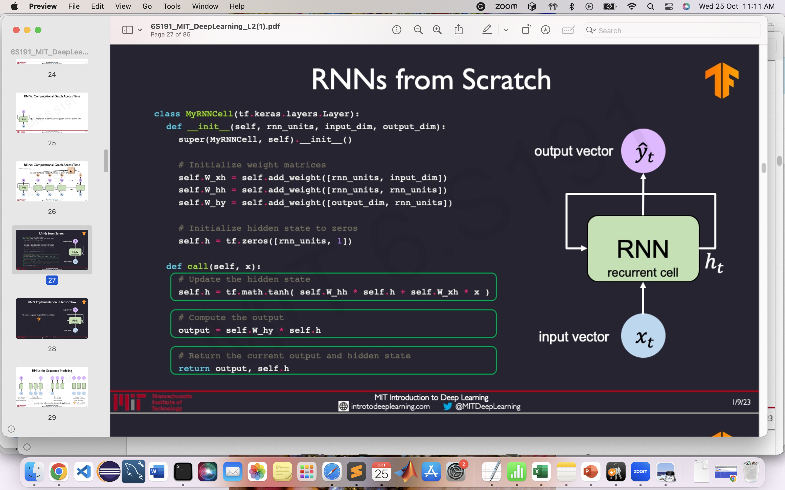
RNNs from Scratch
Yt
Output Vector
RNN
Recurrent cell
h_{t}
Input Vector
Xt
RNN Implementation in TensorFlow:
tf.keras.layers.SimpleRNN(rnn_units)
[Source: https://tinyurl.com/3pawnch9 ]
19

Slide 20
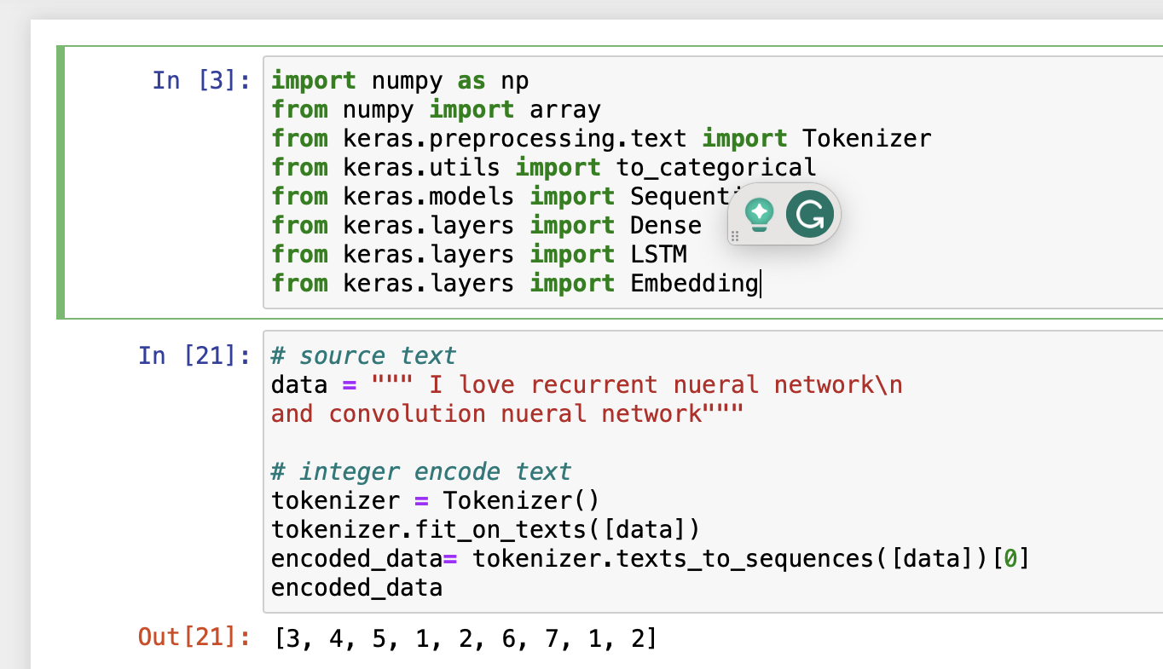
RNN Example : Predict Next Word in Sequence
1] Import the libraries and to train our model we need to add some data or Source text.To encode text to an array of numbers we use Tokenizer from keras: This class allows to vectorize a text corpus, by turning each text into either a sequence of integers (each integer being the index of a token in a dictionary) or into a vector where the coefficient for each token could be binary, based on word count, based on tf-idf.
GitHub link: https://github.com/KhushbuKathrotiya/RNN_Next_Sequence_Word

Slide 21
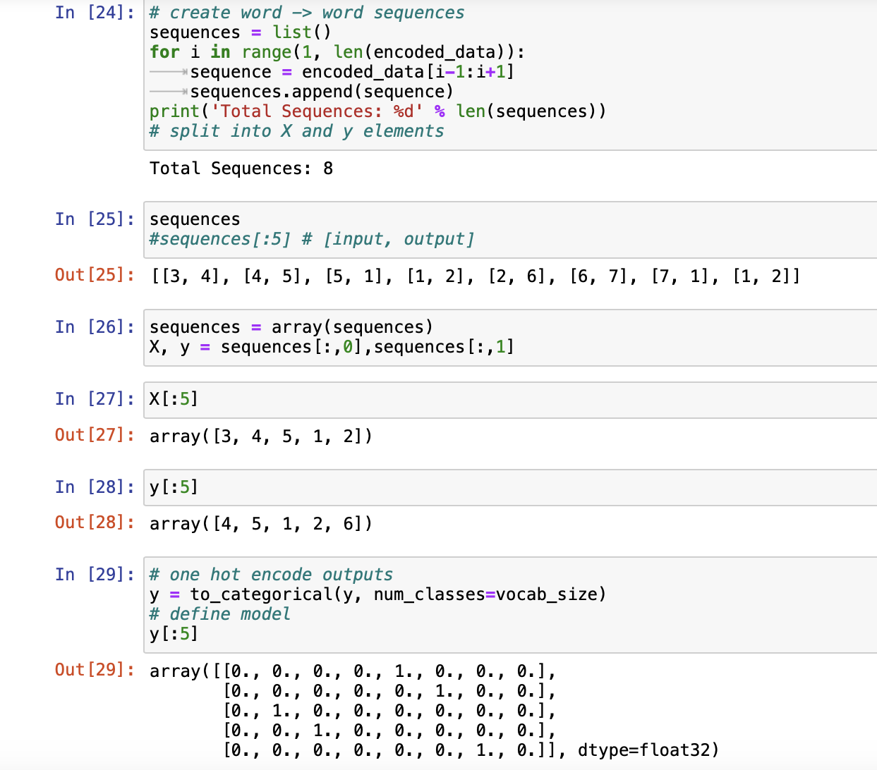
Predict Sequence Next Word
2] Creating encoded sequences to get the data of specified length and the vocabulary. We use one-hot encoding to map output where the number of classes are number of given words in the vocabulary.
GitHub link: https://github.com/KhushbuKathrotiya/RNN_Next_Sequence_Word

Slide 22
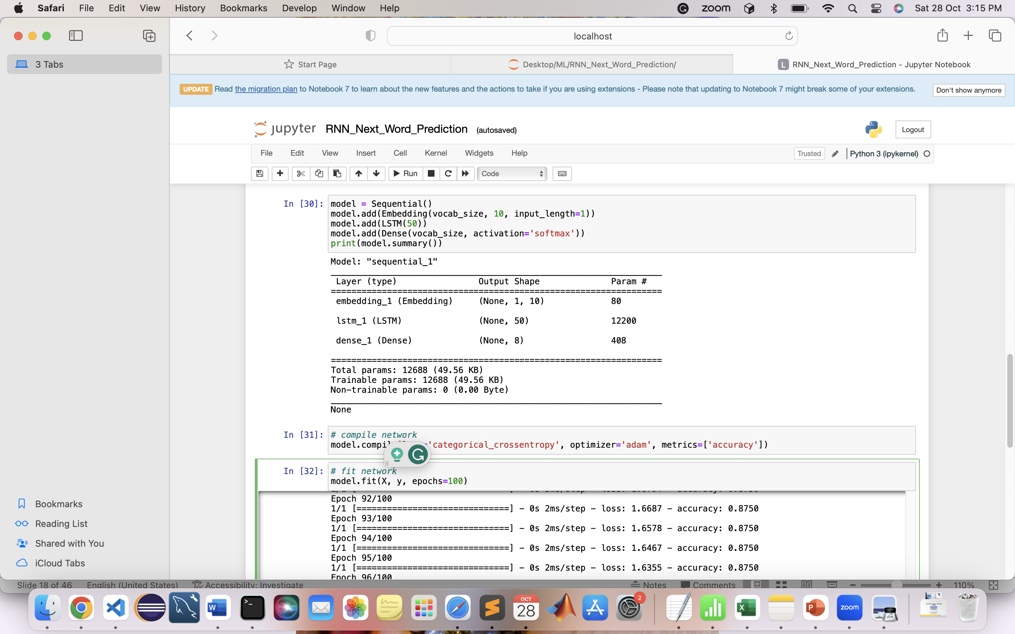
Predict Sequence Next Word
3] Creating embeddings and LSTM model and training model using categorical crossentropy as loss function, where accuracy is used as an evaluation metric.
GitHub link: https://github.com/KhushbuKathrotiya/RNN_Next_Sequence_Word

Slide 23
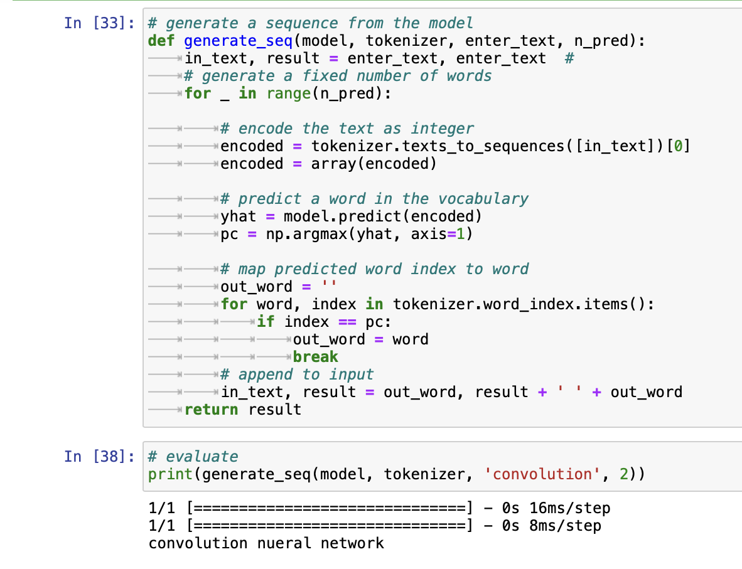
Predict Sequence Next Word
4] Inference code is given in below figure: Once the model is trained, the below function is used to predict the next word. First, create encoded sequences that are from words to array of numbers which is then fed to the trained model. Once the word with maximum probability is obtained, it is mapped back to the word from the given vocabulary.
GitHub link: https://github.com/KhushbuKathrotiya/RNN_Next_Sequence_Word

Slide 24
Sequence Modeling: Design Criteria
Yt
To model sequences, we need to:
Handle variable length sequence
Track long-term dependencies
Maintain information about order
Share parameters across the sequence
RNN
Xt
[Source: https://tinyurl.com/3pawnch9 ]
Recurrent Neural Networks(RNNs) meets
these sequence modeling design criteria
24

Slide 25
A Sequence Modeling Problem: Predict the Next Word
“This morning I took my cat for a walk”
Representing language to a Neural Network
0.1
0.8
0.6
0.9
0.2
0.4
“deep”
“Learning”
Neural networks cannot interpret words
Neural networks require numerical inputs
[Source: https://tinyurl.com/3pawnch9 ]

Slide 26
Encoding Language for a Neural Network
0.1
0.8
0.6
0.9
0.2
0.4
“deep”
“Learning”
Neural networks cannot interpret words
Neural networks require numerical inputs
Embedding: transform indexes into a vector of fixed size.
cat
a → I
cat → 2
… …
Walk → N
One-hot embedding
Learned embedding
this
for
took
“cat” = [ 0, I, 0, 0, 0, 0 ]
run
walk
dog
cat
my
walk
I
day
sun
happy
sad
a
i-th index
morning
1. Vocabulary:
Corpus of words
2. Iendexing:
Word to index
3. Embedding:
Index to fixed-sized vector
[Source: https://tinyurl.com/3pawnch9 ]
26

Slide 27
Handle Variable Sequence Lengths
The food was great
vs.
We visited a restaurant for lunch
vs.
We were hungry but cleaned the house before eating
27

Slide 28
Model Long-Term Dependencies
“France is where I grew up, but I now live in Boston. I speak fluent ___.”
We need information from the distant past to accurately
predict the correct word.
J’aime 6.SI9I!
28

Slide 29
Capture Differences in Sequence Order
The food was good, not bad at all.
vs.
The food was bad, not good at all.
29

Slide 30
Recall: Backpropagation in Feed Forward Models
y
Backpropagation algorithm:
Take the derivative(gradient) of the loss with respect to each parameter.
Shift parameters in order to minimize loss
x
[Source: https://tinyurl.com/3pawnch9 ]
30

Slide 31
RNNs: Backpropagation Through Time
L
Forward Pass
Backward Pass
L0
L1
L2
L3
Yt
Y0
Y1
Y2
Yt
W_{hy}
W_{hy}
W_{hy}
W_{hy}
RNN
W_{hh}
W_{hh}
W_{hh}
W_{xh}
W_{xh}
W_{xh}
W_{xh}
Xt
X0
X1
X2
Xt
[Source: https://tinyurl.com/3pawnch9 ]
31

Slide 32
Standard RNN Gradient Flow
h₀
h_{t}
W_{hh}
W_{hh}
W_{hh}
W_{xh}
W_{xh}
W_{xh}
W_{xh}
X0
X1
X2
Xt
[Source: https://tinyurl.com/3pawnch9 ]
Computing the gradient w.r.t h₀ involves many factors of W_{hh} + repeated gradient computation!
Many values > 1
exploding gradients
Gradient clipping to
scale big gradients
Many values < 1:
vanishing gradients
Activation function
Weight initialization
Network architecture
32

Slide 33
Problem of long-term dependencies
Recurrent Neural Network (RNN) is used for modeling sequential information and is a state-of-the-art deep learning algorithm.
Recurrent neural networks struggle to learn dependencies between inputs that are separated by many time steps.
As information passes through the RNN, the signal gets diluted over time, making it challenging to capture long-term dependencies.
This limitation is known as the vanishing gradient problem and hampers the ability of vanilla RNNs to model sequences with long-range temporal structures.
Capturing long-term dependencies in sequential data is a basic challenge in many fields, such as NLP, speech recognition, and time series analysis. [5]

Slide 34
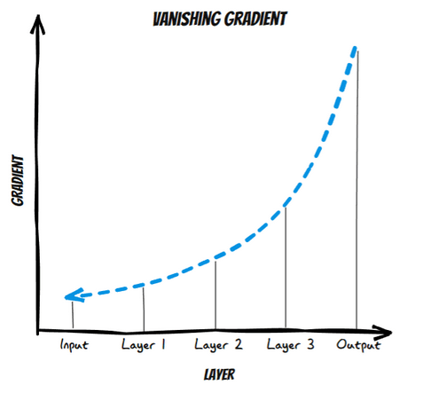

[Source: https://tinyurl.com/y4x357kk ]
34

Slide 35
Introduction to LSTMs
LSTMs (Long-Short Term Memory) are a type of recurrent neural network that contains memory cells, allowing them to remember values over long periods of time.
They have gates that regulate the flow of information, allowing them to selectively remember or forget past information.[6]

Slide 36

Short video explaining LSTM
[Source: https://www.youtube.com/watch?v=5dMXyiWddYs&ab_channel=SkillC ]

Slide 37
LSTM Architecture
Forget Gate
Input Gate
Output Gate
Decides what information to remove from the cell state based on the previous hidden state and current input. Outputs number between 0-1 indicating importance.
Decide what new information to add to the cell state.
Create new candidate values to add.
Decides what parts of the cell state to output. Scales cell state between -1 and 1.
[Source: https://tinyurl.com/mrycxxp5 ]

Slide 38
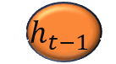
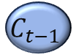
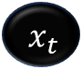















$$h_{t}$$
Inputs:
Non-linearities:
$$x_{t}$$
Input Vector
tanh
Hyperbolic tangent
$$x_{t}$$
×
$$h_{t−1}$$
+
σ
$$h_{t−1}$$
Output of previous block
Sigmoid
tanh
$$C_{t−1}$$
σ
3
$$C_{t}$$
$$x_{t}$$
Memory from previous block
$$C_{t−1}$$
0
Bias
Cell
×
σ
+
$${hh_{t−1} }_{t}$$
$$C_{t−1}$$
$$x_{t}$$
Outputs:
$$C_{t−1}$$
0
$$h_{t−1}$$
+
σ
$$h_{t}$$
Output of current block
+
1
Memory from current block
tanh
$$C_{t}$$
×
Vector operations:
+
+
Element-wise summation/Concatenation
$$x_{t}$$
2
$$h_{t−1}$$
Element-wise multiplication
×
[Source: https://tinyurl.com/mrycxxp5 ]
38
Notes:
Cell state acts as highway to transfer information throughout the sequence chain.
Cell state can be seen as the memory of the network. It can bring back information from earlier time steps to later time steps reducing the effect of short-term memory loss.
The primary reason why bias is required in neural networks is that, without bias weights, your model would have very limited movement when looking for a solution.

Slide 39


Forget Gate
Decides Information to Discard
Inputs
Forgetting
Optimization
Cell State
Uses a sigmoid layer to output values between 0 and 1 indicating which parts of the cell state to discard.
Takes the hidden state (ht-1) from the previous cell and the current input (xt).
Values close to 0 means discard that part of the cell state; values close to 1 mean keep that part.
Forgetting irrelevant information optimizes the LSTM network's performance.
Multiplies output of sigmoid layer with cell state to selectively forget information.
[Source: https://tinyurl.com/mrycxxp5 ]

Slide 40



This is the forget gate that shuts the irrelevant memory.
Inputs:
Non-linearities:
$$x_{t}$$
Input Vector
tanh
Hyperbolic tangent
$$h_{t−1}$$
Output of previous block
Sigmoid
σ
$$C_{t−1}$$
Memory from previous block
0
Bias
$$x_{t}$$
Outputs:
σ
+
$${hh_{t−1} }_{t}$$
$$h_{t}$$
Output of current block
$$C_{t−1}$$
0
$$C_{t}$$
Memory from current block
[Source: https://tinyurl.com/mrycxxp5 ]
Vector operations:
+
Element-wise summation/Concatenation
×
Element-wise multiplication

Slide 41
Input Gate
Introduction
Working
Role
The input gate regulates what new information to add to the cell state. It decides which values should be updated in the cell state.
The input gate works in three steps:
A sigmoid layer filters candidate values.
A tanh layer creates candidate values.
The sigmoid output is multiplied by the tanh output to get the updates.
The input gate helps the LSTM selectively add only relevant new information to the cell state.
Optimizes Performance
Key Component
By preventing redundant information, the input gate optimizes the performance of the LSTM network.
Provides Control
The input gate is a key component of the LSTM architecture.
The input gate provides precise control over what enters the cell state.
[Source: https://tinyurl.com/mrycxxp5 ]

Slide 42
The sigmoid output is multiplied by the tanh output to get the updates
Inputs:
Non-linearities:
$$x_{t}$$
Input Vector
tanh
Hyperbolic tangent
$$h_{t−1}$$
Output of previous block
Sigmoid
σ
$$C_{t−1}$$
Memory from previous block
0
Bias
Cell
Outputs:
$$h_{t}$$
Output of current block
σ
+
$$C_{t}$$
Memory from current block
×
tanh
[Source: https://tinyurl.com/mrycxxp5 ]
Vector operations:
+
Element-wise summation/Concatenation
×
Element-wise multiplication
Notes:
What is bias in a neural network? In simple words, neural network bias can be defined as the constant which is added to the product of features and weights

Slide 43

The two gates here are responsible for actively merging the old memory and the new memory to create Ct (green arrow), which is subsequently fed back into the main "Cell."
Inputs:
Non-linearities:
$$x_{t}$$
Input Vector
tanh
Hyperbolic tangent
$$h_{t−1}$$
Output of previous block
Sigmoid
σ
$$C_{t−1}$$
Memory from previous block
0
Bias
$$C_{t−1}$$
Outputs:
$$h_{t}$$
Output of current block
Cell
×
$$C_{t}$$
Memory from current block
σ
+
Vector operations:
×
tanh
+
Element-wise summation/Concatenation
[Source: https://tinyurl.com/mrycxxp5 ]
Element-wise multiplication
×

Slide 44
Output Gate
Vector Multiplication
Pass to Hidden State
Select Relevant Information
Sigmoid Layer
tanh Layer
Outputs numbers between 0 and 1 to select which parts of the cell state to keep.
Transforms the cell state into the -1 to 1 range.
The sigmoid and tanh vectors are multiplied to yield the relevant parts of the cell state.
The output of the vector multiplication becomes the next hidden state.
The output gate selects the relevant parts of the cell state to pass to the hidden state.
[Source: https://tinyurl.com/mrycxxp5 ]

Slide 45




Inputs:
Non-linearities:
Output gate and output unit of LSTM
$$x_{t}$$
Input Vector
tanh
Hyperbolic tangent
$$h_{t−1}$$
Output of previous block
Sigmoid
σ
$$h_{t}$$
$$C_{t−1}$$
Memory from previous block
0
Bias
$$x_{t}$$
×
Outputs:
$$h_{t−1}$$
+
σ
tanh
$$h_{t}$$
Output of current block
3
$$C_{t}$$
Cell
Memory from current block
$$C_{t}$$
[Source: https://tinyurl.com/mrycxxp5 ]
Vector operations:
+
Element-wise summation/Concatenation
×
Element-wise multiplication

Slide 46
RNN Advantages and Disadvantages
Advantages
Disadvantages
Possibility of processing input of any length
Model size not increasing with the size of the input
Computation considers historical information
Weights are shared across time[7]
Computation is slow
Difficulty accessing information from a long time ago
Cannot consider any future input for the current state[7]

Slide 47
YouTube Video links:
https://youtu.be/ySEx_Bqxvvo?si=jHxqk5DrS8hoTnh7
https://youtu.be/NmLK_WQBxB4?si=kvUWczk7PkJ_xFlc
https://youtu.be/JgnbwKnHMZQ?si=hsVA6WVX0l37-Hdu
https://www.youtube.com/watch?v=5dMXyiWddYs&ab_channel=SkillC

Slide 48
References
[1] “What is a convolutional neural network?: 3 things you need to know,” What Is a Convolutional Neural Network? | 3 things you need to know - MATLAB &amp; Simulink, https://tinyurl.com/pk7jrwnm (accessed Oct. 27, 2023).
[2] Group, “Recurrent Neural Network and Long Term Dependencies,” Medium, Mar. 09, 2020. https://tinyurl.com/m9cxvuj (accessed Oct. 18, 2023).
[3] L. Craig, “CNN vs. RNN: How are they different?: TechTarget,” Enterprise AI, https://tinyurl.com/3ukwrsjy (accessed Oct. 27, 2023).
[4] MIT Deep Learning 6.S191, https://tinyurl.com/3pawnch9 (accessed Oct. 1, 2023).
[5] Deep learning, https://www.deeplearningbook.org/contents/rnn.html (accessed Oct. 13, 2023).
[6] S. Yan, “Understanding LSTM and its diagrams,” Medium, https://tinyurl.com/mrycxxp5 (accessed Oct. 27, 2023).
[7] “Recurrent neural networks cheatsheet star,” CS 230 - Recurrent Neural Networks Cheatsheet, https://tinyurl.com/yc5t3xy3 (accessed Oct. 27, 2023).

